Slide 1

A Vision to Expand, Promote, and Assess Teaching & Learning
Matthew Weirick Johnson, MSLS
Towson University
1 December 2021
academic.mattweirick.com

Slide 2

Introduction
Bachelor of English in Literature & Language; Virginia Tech, Blacksburg, VA
Master of Science in Library Science; University of North Carolina, Chapel Hill, NC
Graduate Certificates: SILS Diversity Advocate, Interdisciplinary Health Communication, Interdisciplinary Health Disparities
Community Workshop Series Coordinator
UCLA Library – Associate Librarian
Librarian for English, History, and Comparative Literature, Humanities & Social Sciences Lead for Research Services, and Lead for Teaching & Learning

Slide 3

Agenda
Background Information & Considerations
An Immodest Proposal
Wrap-up
Photo by Estée Janssens on Unsplash

Slide 4

Background Information & Considerations

Slide 5
Prompt
Please design and deliver a 30-40 minute presentation discussing your vision to expand, promote, and assess Cook Library’s course-integrated instruction program. Please address the following points:
What type of leadership role will you take?
How will you plan to leverage the Student Success Librarian position, Special Collections and University Archives, the new credit-bearing information literacy course, partners across campus, and the new university and library strategic plan during this process?
What emerging trends or innovations will you invoke?
What challenges and opportunities do you see?

Slide 6
Anti-Racism Statement
Research and Instruction will complete an examination and assessment of instruction strategies, activities, and the department will also provide for regular review of instruction practices to demonstrate anti-racist pedagogy.
Complete a user experience study to assess the experiences of BIPOC students in the library and with library representatives in the classroom and report findings publicly so that we may use them to inform change in our spaces, services and interactions.

Slide 7
Strategic Plan
Review the effectiveness of our instruction program and lessons learned from virtual instruction, including implementing a for-credit course, mapping high impact courses, and determining asynchronous vs. synchronous one-shot best practice.
Support a diversity-rich learning experience for students by increasing diversity in library purchased or subscribed collections, unique collections, and instruction practice. Establish appropriate partnerships to meet this action.
Make digital and physical services more accessible.
Support students' experiential learning and internship/field study experiences in the library and across campus, including students pursuing entrepreneurship, startup, and venture creation opportunities.

Slide 8
Strategic Plan
Expand the depth and intentionality of campus and community partnerships and cement the library's role in supporting an anchor institution.
Strengthen relationships with various offices in Student Affairs including the Counseling Center, Career Center, etc.
Make course materials more affordable by purchasing textbooks, creating web list of library-owned textbooks, and offering consultation on low- and no-cost alternatives to faculty.
Provide engaging student assistant and volunteer experiences.
Implement a culture of assessment with routinized assessment of library work.

Slide 9
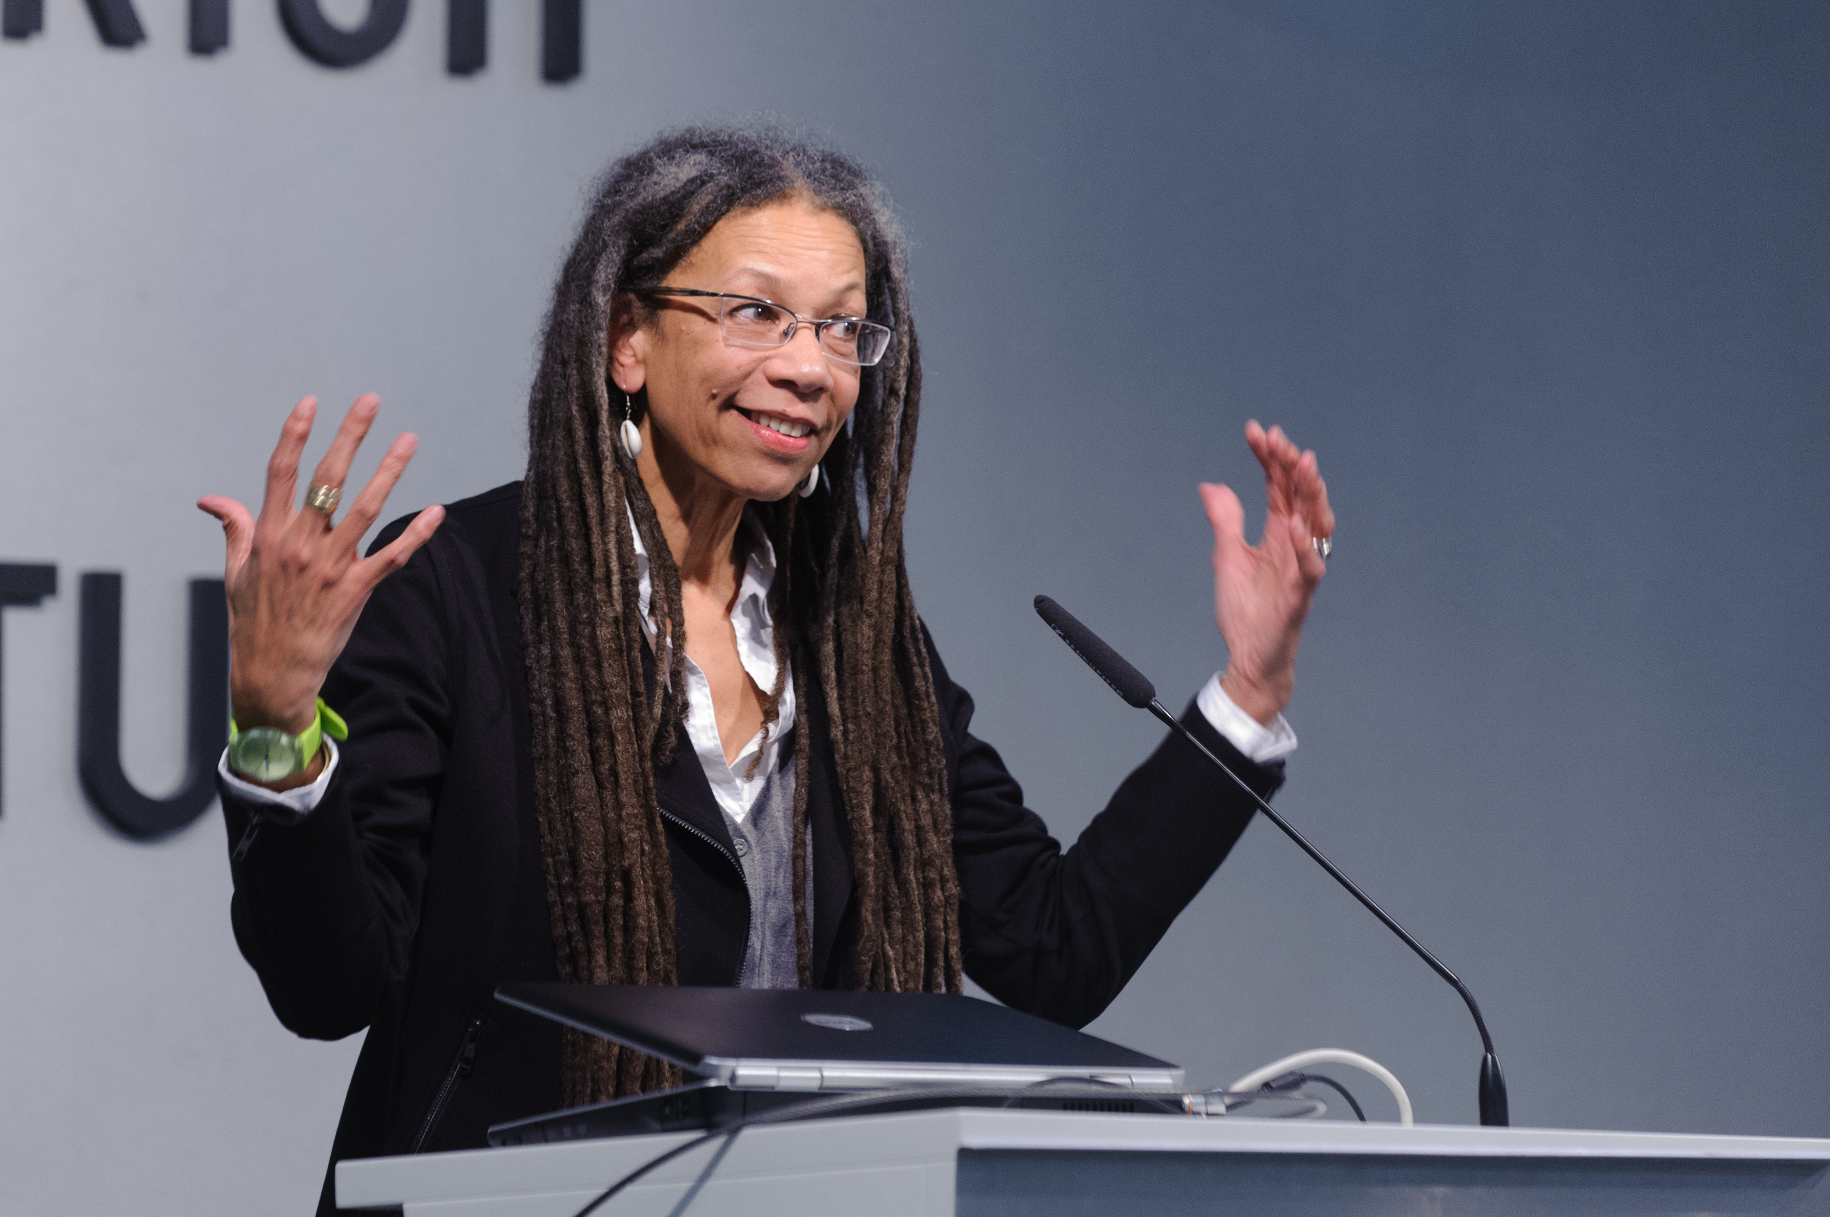
Ruth Wilson Gilmore
“Sit on committees that make decisions, not committees that make reports”
Photo by Stephan Röhl, CC BY-SA 2.0 via Wikimedia Commons

Slide 10

An Immodest Proposal
Learner- and User-centered Design
Delivery, Scalability, Efficiency and Reusability
Authentic Assessment
Innovation & Change Management
Accessible & Anti-Racist Pedagogy

Slide 11
Learner- & User-Centered Design

Slide 12
Library Advisory/Advocacy Board
Made up of students or students, faculty, and staff
Often faculty already have input through Faculty Senate or other university governance structures
Allows direct engagement & input with user community and creates a continued system for this communication – input on services, policies, spaces, programming, etc.
Provides an opportunity for active listening and shared decision-making
Promote EDI by centering people from historically oppressed groups
Budget & Recruitment
Support assessment and accountability

Slide 13
Learner-Centered Design & Universal Design
Being value-driven — what are our shared values?
Incorporating EDIA, Social Justice, Learner-Centered, and Universal Design principles into instructional resources and approaches
Peer-to-peer services — What can we learn from our learners?
Centering learners from historically marginalized and oppressed groups

Slide 14

Delivery, Scalability, Efficiency, Reusability

Slide 15

Asynchronous & Synchronous Delivery
Learning from the pandemic
Alignment with content and learning outcomes
Prioritizing meaningful and transformative learning collaborations

Slide 16
Scalable Instruction
Reusable modular content for synchronous, asynchronous, and hybrid instruction
Learner-centered development of scalable and reusable content
Anticipating need, recognizing capacity, building capacity

Slide 17

Authentic Assessment

Slide 18
Assessment as Care
Centering care in the process of assessment
Assessment for well-being and growth
Not assessment for the sake of assessment

Slide 19

Programmatic and Sustainable Assessment
Assessment at scale
Use existing data to inform the approach to assessment
Systematically assess programs and outcomes

Slide 20

Innovation & Change Management

Slide 21
Some Ideas
One-shots, credit-bearing courses and the organization of labor in library instruction
Campus partnerships & student success
Leveraging collections (open textbooks, open scholarship, open educational resources, special and digital collections)

Slide 22
Accessible & Anti-Racist Pedagogy

Slide 23

Wrapping Up

Slide 24

Some of my DEIA Work
Anti-Racist Pedagogy Workshop Series
Honors 101i: Research Today: Sources, Tools, and Strategies
The Mellon Mays Undergraduate Fellowship Writing and Research Training Program at UCLA
User Engagement Accessibility Committee
UCLA Library Diversity, Equity & Inclusion Committee
UCLA Library Unified Access Services & User Engagement Anti-Racism Cross-Functional Team
UCLA Sexual Health Coalition
ACRL Instruction Section Diversity and Inclusion Task Force
North Carolina AIDS Action Network
Planned: Research Practice 110A: Careers in Libraries & Archives

Slide 25
Bibliography
Agyen, A., Araújo, J., Johnson, M. W., Lee, S., Newby, A., Romero, R. & Westrup, L. (under review). “Writing and Research Training Program: A UCLA Campus Partnership to Support BIPOC, LGBTQIA, and Disabled Student Researchers.” In Hensley, M.K., Fargo, H.M. & Davis-Kahl, S. (Eds.), Undergraduate Research and the Academic Librarian: Case Studies & Best Practices, Volume 2.
Arellano Douglas, V. (2020). Moving from critical assessment to assessment as care. Communications in Information Literacy, 14(1), 4.
Harper, T., Mody, N., Ravaei, K., Romero, R., & Worsham, D. (2020). The WI+ RE Way. Journal of New Librarianship, 5(1), 1-24.
Johnson, M. W., Abumeeiz, S., & McAulay, E. (2021). Teaching in the digital library: A partnership between teaching librarians and digital library staff. College & Research Libraries News, 82(7), 302.
Johnson, M. W., & Lasher, M. (2020). The Community Workshop Series: A Case Study for Community-Engaged Learning in LIS. Library Trends, 69(4), 752-767.

Slide 26



Contact Me
Matthew Weirick Johnson
academic.mattweirick.com
matt@mattweirick.com

